Slide 1
Literary devices of
Rikki-tikki-tavi
Literary Techniques
Literary Elements

Slide 2
Literary devices
Literary devices are common structures in writing that make up the components of literature. We use these devices to help us interpret and analyze literary works. The names of literary devices may also be called literary terms. Literary devices include both literary techniques and literary elements.

Slide 3
Literary techniques
Are tools that an author may choose to use to enhance their writing and to convey meaning in a certain way. Figurative language, sound devices, and foreshadowing are examples of literary techniques.
Figurative Language
Sound Devices
Foreshadowing
The use of figures of speech, which are words or phrases that depart from everyday literal language in order to compare or to add emphasis and clarity. Authors use figurative language to add interest and to evoke certain feelings in their readers. There are many different types of figurative language that authors may choose to use in their writing.
These are techniques or tools that writers can use to add meaning and emphasis to writing through the use of sound. There are a number of different types of sound devices.
Is when the author gives hints or clues to suggest what will happen as the story progresses.

Slide 4

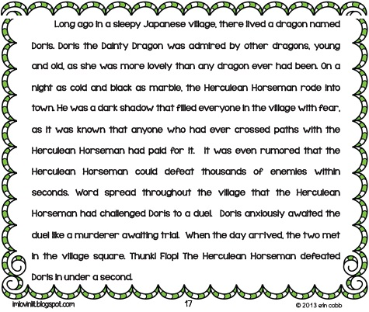
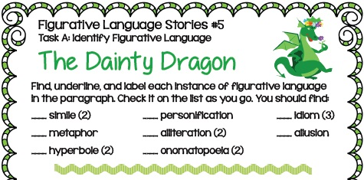

Slide 5
Literary elements
These are the essential parts of storytelling that are found in almost all types of literary and narrative writing.
Plot
Plot Elements
Character
Conflict
Setting
Theme
The plot is how the author arranges events to develop his basic idea. It is the sequence of events in a story or play. The plot is a planned, logical series of events having a beginning, middle, and end. The short story usually has one plot so it can be read in one sitting. There are five essential parts of plot: introduction, rising action, climax, falling action, and resolution.
A.) Introduction - The beginning of the story where the characters and the setting are revealed. The introduction can also be called the exposition.
B.) Rising Action - This is the part of the story were a conflict is revealed (called the inciting force) and becomes more pronounced as the story progresses. The rising action is all the events between the introduction and the climax.
C.) Climax - This is the highest point of interest, the turning point of the story or the moment of greatest suspense. The reader wonders what will happen next; will the conflict be resolved or not?
D.) Falling Action - At this point the events and complications begin to resolve themselves. The falling action is all of the events between the climax and resolution.
E.) Resolution - This is the final outcome or untangling of events in the story. The resolution may also be called the denouement.

Slide 6
Character
A.) Protagonist - The main or central character.
B.) Antagonist - This character opposes the protagonist. Often, he or she is an opponent to the main character.
We learn about a character in 5 different ways:
1.) What the character says. 2.) What the character thinks. 3.) What the character does. 4.) What is said about him or her by other characters and the narrator. 5. ) What the author says about the character.
The plot can only exist with characters. The main character is placed in a situation that contains a problem he or she must overcome; therefore, conflict exists. Most stories also have minor characters who either help or hinder the main character's attempt to solve the conflict. There can be many different types of characters within a story.

Slide 7
Literary elements
Conflict
Setting
Conflict does not involve just arguments, but rather it is any form of opposition that faces the main character. Within a short story there may be only one central struggle, or there may be one dominant struggle with many minor ones.
There are 4 different types of conflict:
1.) Character vs. Person / Character vs. Character: The leading character struggles with his or her physical strength against other characters, forces of nature, or animals.
2.) Character vs. Circumstances / Character vs. Nature: The leading character struggles against fate, or the circumstances of life facing him/her.
3.) Character vs. Society: The leading character struggles against ideas, practices, or customs of other people.
4.) Character vs. Self: The leading character struggles with himself/herself; with his/her own soul, ideas of right or wrong, physical limitations, choices, etc.
The time (when) and location (where) in which a story takes place is called the setting.
There are 5 ways to determine setting:
1.)Place - Geographical location. Where is the action of the story taking place?
2.)Time - When is the story taking place? (historical period, time of day, year, etc)
3.)Weather conditions - Is it rainy, sunny, stormy, etc?
4.) Social conditions – What is the character's daily life like? Is the character influenced by particular customs or mannerisms of a place?
5.) Mood or atmosphere - What feeling is created at the beginning of the story? Is it bright and cheerful or dark and frightening?

Slide 8
Literary elements
Theme
A theme is the author's underlying meaning, message or main idea that he is trying to convey.
Some examples of themes from literature include:
- Things are not always as they appear to be
- Love is blind
- Believe in yourself
- People are afraid of change
- Don't judge a book by its cover

Slide 9
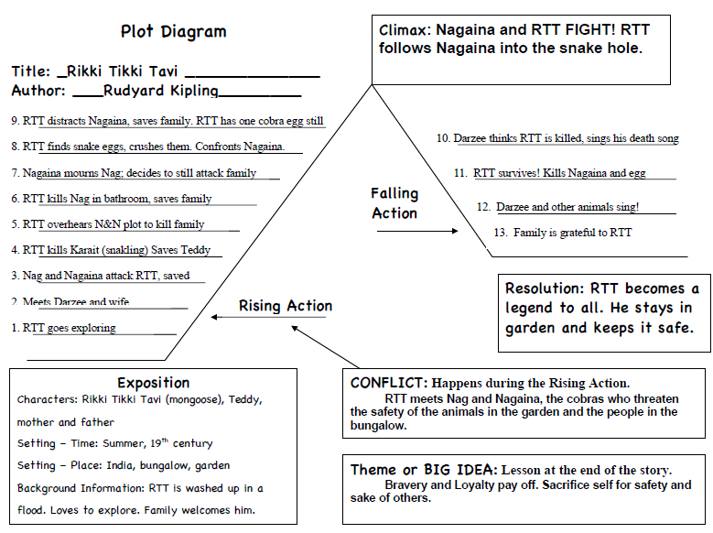
Rikki-tikki-tavi – Plot diagram

